Slide 1
NFT CARD GAME
RONDO
Play to win, Let the Battle Begain !
Ahmed Abdul Aziz Mohamed 320210266
Mohamed Omar Abdul Aziz 320210267

Slide 2
TABLE OF CONTENTS
IDEA
Related Projects
Functions & Technologies
METHODOLOGY
Interface
CONCLUSION
01
02
Breif Explanintaion of the idea and what we do
Related work and projects similar to our idea
03
04
The used technologies for the project
The steps were taken to implement the project
05
06
Shows the project and the interface
Conclude the idea and the purpose of the project

Slide 3
IDEA
01
Breif Explanintaion of the idea and what we do

Slide 4
IDEA
RONDO
NFT games are Play-to-Earn (P2E) games that give users more control over in-game assets. They make it possible as the in-game items are NFTs that you can buy
NFT-based card game, Rondo, built on the blockchain using Solidity and web3

Slide 5
Related Projects
02
Related work and projects similar to our idea

Slide 6
Related Projects
We are not pioneers in the concept of NFT based games.
Numerous examples already exist, showcasing the potential and popularity of this innovative approach.
We aim to build upon these successes and contribute to the evolving landscape of block chain gaming.

Slide 7



Related Projects
Crypto Kitties
Gods Unchained
Axis Infinity
Allows players to breed and trade unique digital cats.
Players collect, battle, and trade fantastical creatures called Axies.
A blockchain-based trading card game.

Slide 8
Functions & Technologies
03
Technologies used for project

Slide 9



Technologies
React is using for building user interfaces based on components
React js
Programming language and core technology of the Web, alongside HTML and CSS.
Front-End
Java-Script
Presentation and styling of a document written in a markup language such as HTML
CSS

Slide 10



Technologies
Solidity is a programming language for implementing smart contracts on various blockchain platforms.
Solidity
Hardhat is an Ethereum development environment. Compile your contracts and run them on a development network
Back-End
HardHat
It is designed for the development of large applications and transpiles to JavaScript
Type-Script

Slide 11



Technologies
For interacting with the Ethereum blockchain.
WEB3
MetaMask is a software cryptocurrency wallet used to interact with the Ethereum blockchain
Block-Chain
MetaMask
A Core Wallet is a type of digital wallet used to store, send, and receive cryptocurrency.
Core

Slide 12
Methodology
04
Steps for the building the project

Slide 13
THIS IS A TIMELINE
01
02
03
04
Web3 init
Build Contract
Front-end
Deployment

Slide 14
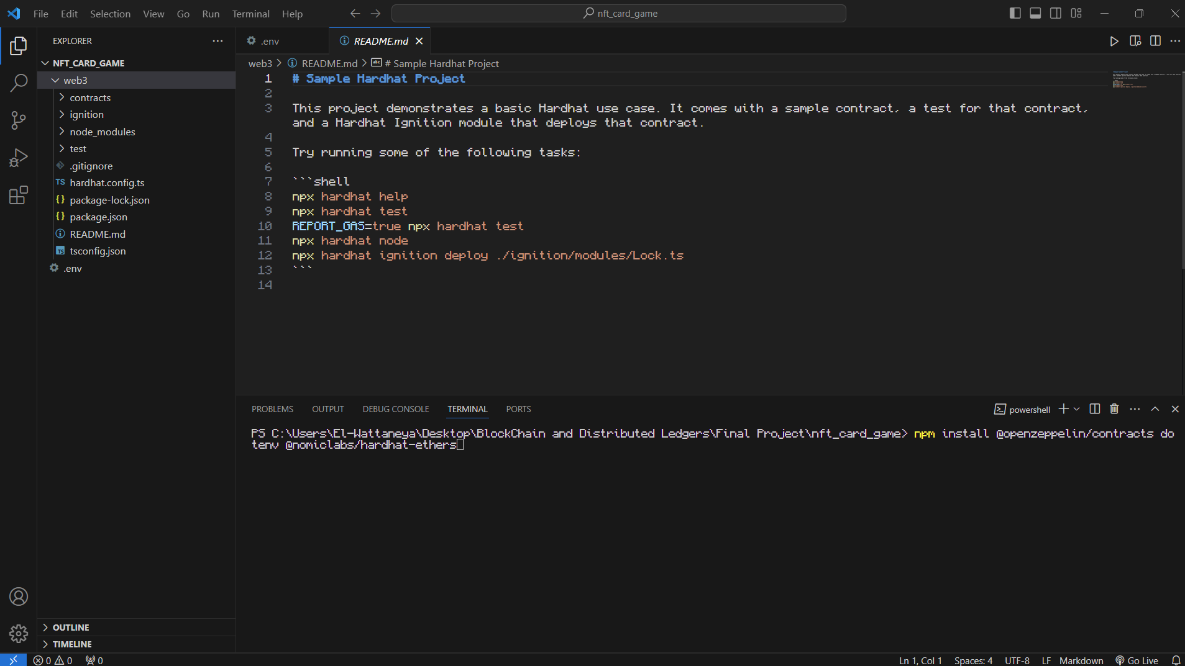
Web3
Hardhat is used to compile, deploy, and test the smart contracts. The deployment configuration is specified in the hardhat.config.js file.

Slide 15
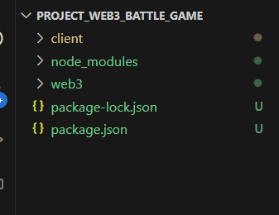
Web3
Hardhat is used to compile, deploy, and test the smart contracts. The deployment configuration is specified in the hardhat.config.js file.

Slide 16
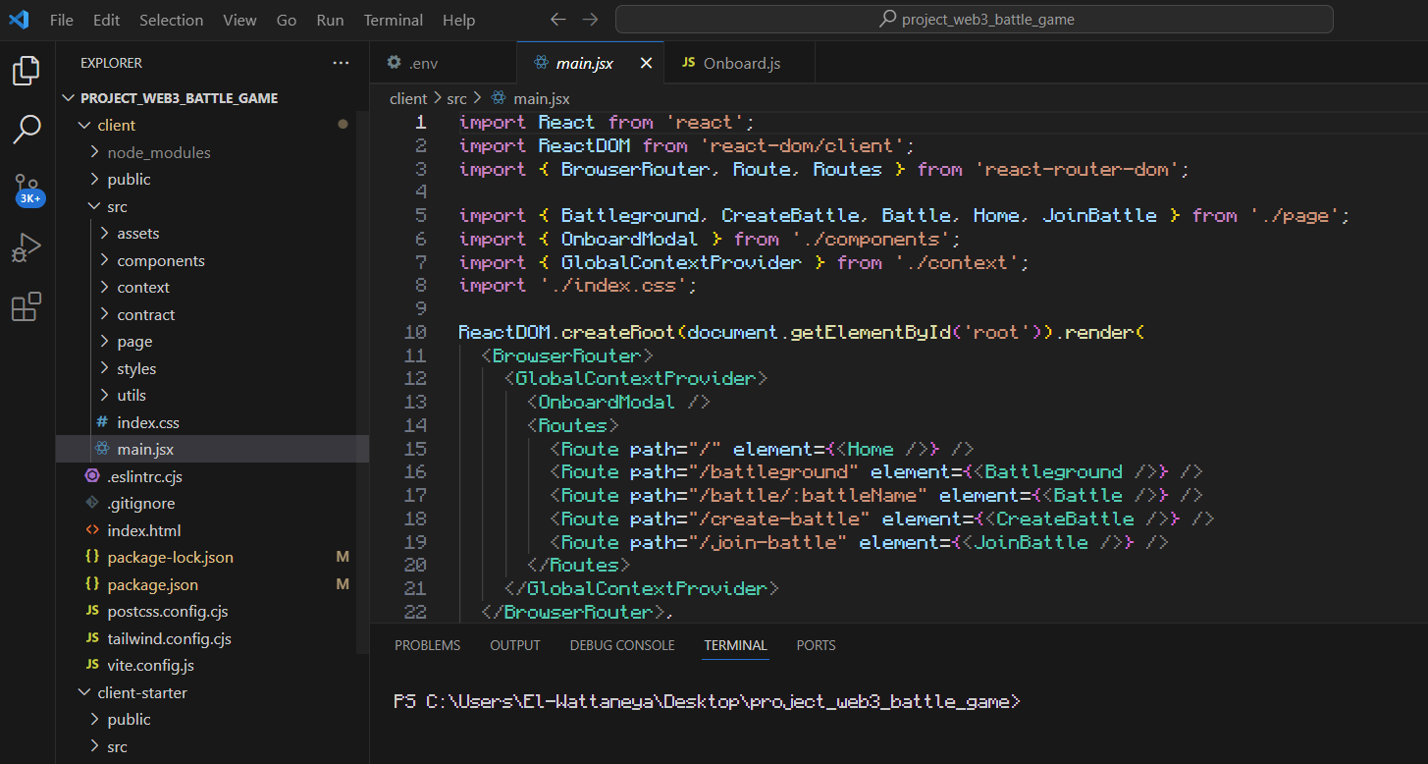
Web3 front
Hardhat is used to compile, deploy, and test the smart contracts. The deployment configuration is specified in the hardhat.config.js file.

Slide 17
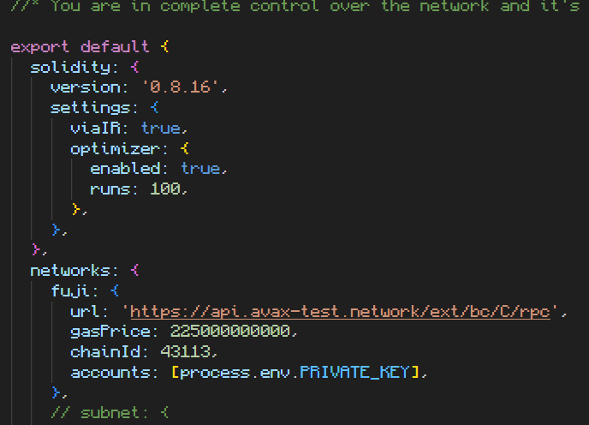
Build Contract
Hardhat is used to compile, deploy, and test the smart contracts. The deployment configuration is specified in the hardhat.config.js file.
Build a Smart contract to define all gameplay mechanics and handle interactions between players, ensuring a fair and transparent gaming experience.
Hardhat is used to compile, deploy, and test the smart contracts. The deployment configuration is specified in the hardhat.config.js file.

Slide 18
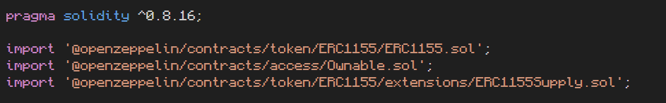
Contract
Hardhat is used to compile, deploy, and test the smart contracts. The deployment configuration is specified in the hardhat.config.js file.
Imports and Inheritance

Slide 19
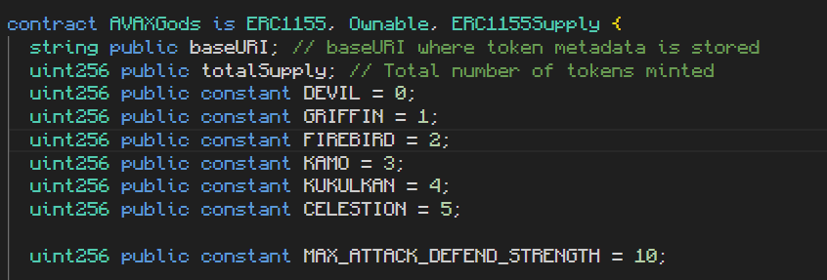
Contract
Hardhat is used to compile, deploy, and test the smart contracts. The deployment configuration is specified in the hardhat.config.js file.
State Variables

Slide 20
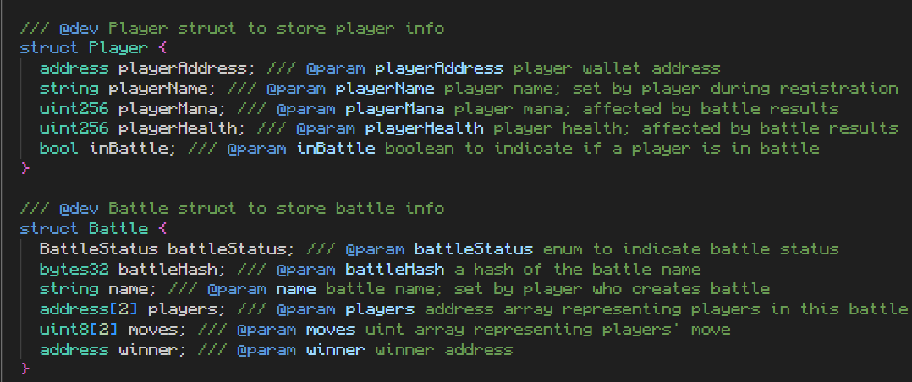
Contract
Hardhat is used to compile, deploy, and test the smart contracts. The deployment configuration is specified in the hardhat.config.js file.
Structs

Slide 21
Contract
Hardhat is used to compile, deploy, and test the smart contracts. The deployment configuration is specified in the hardhat.config.js file.
Mapping
Functions

Slide 22
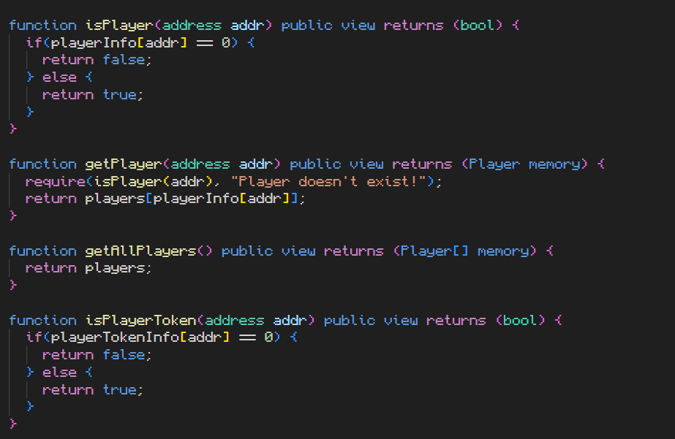
Contract
Hardhat is used to compile, deploy, and test the smart contracts. The deployment configuration is specified in the hardhat.config.js file.
Functions

Slide 23
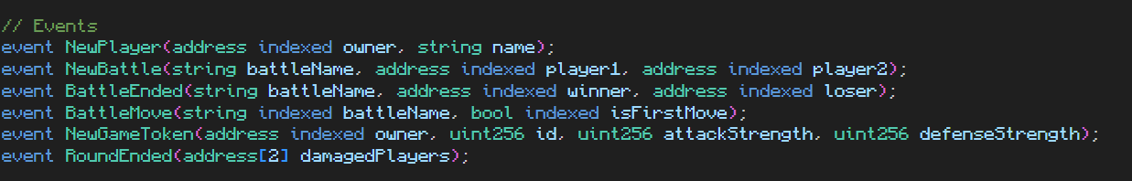
Contract
Hardhat is used to compile, deploy, and test the smart contracts. The deployment configuration is specified in the hardhat.config.js file.
Events

Slide 24
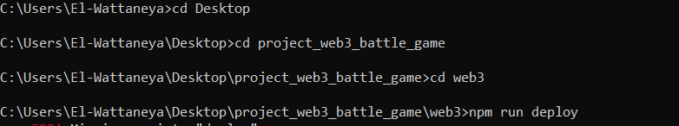
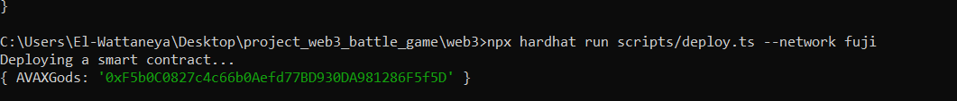
Deployment
Hardhat is used to compile, deploy, and test the smart contracts. The deployment configuration is specified in the hardhat.config.js file.

Slide 25
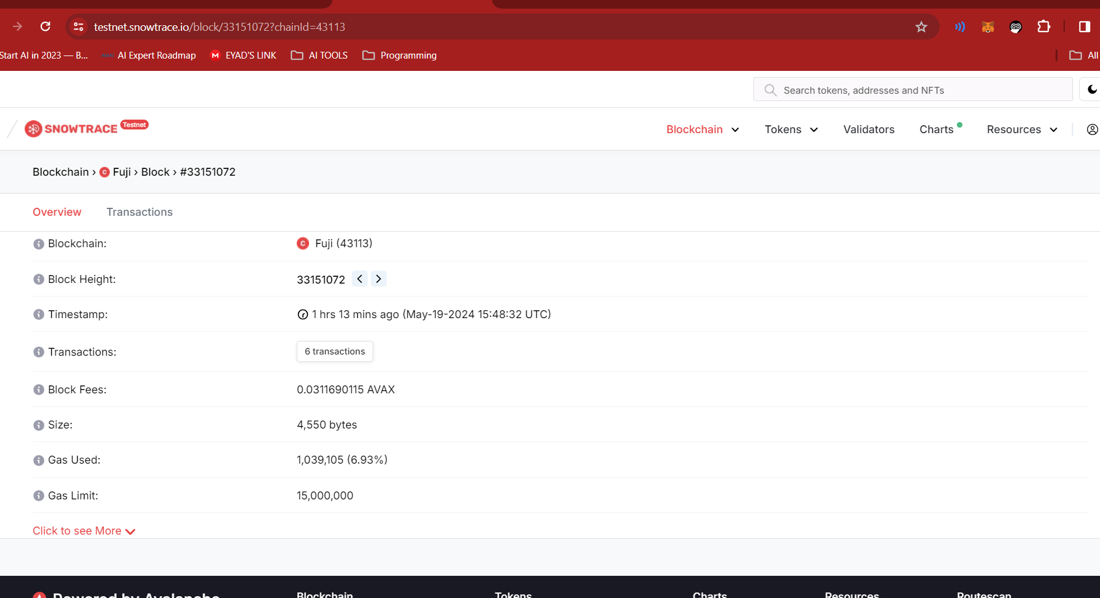
Block-Chain
Hardhat is used to compile, deploy, and test the smart contracts. The deployment configuration is specified in the hardhat.config.js file.

Slide 26
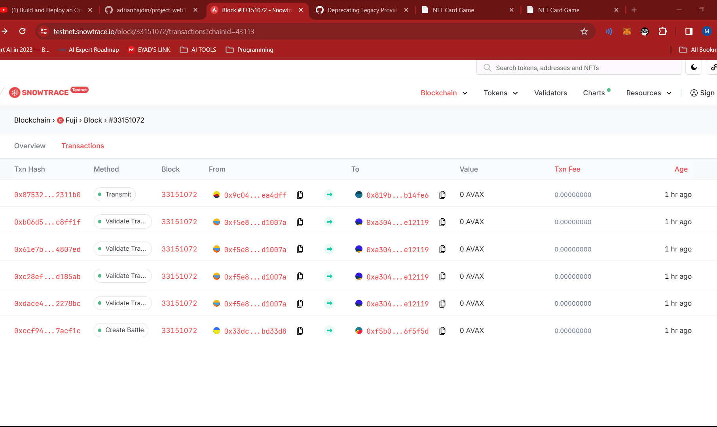
Block-Chain
Hardhat is used to compile, deploy, and test the smart contracts. The deployment configuration is specified in the hardhat.config.js file.

Slide 27
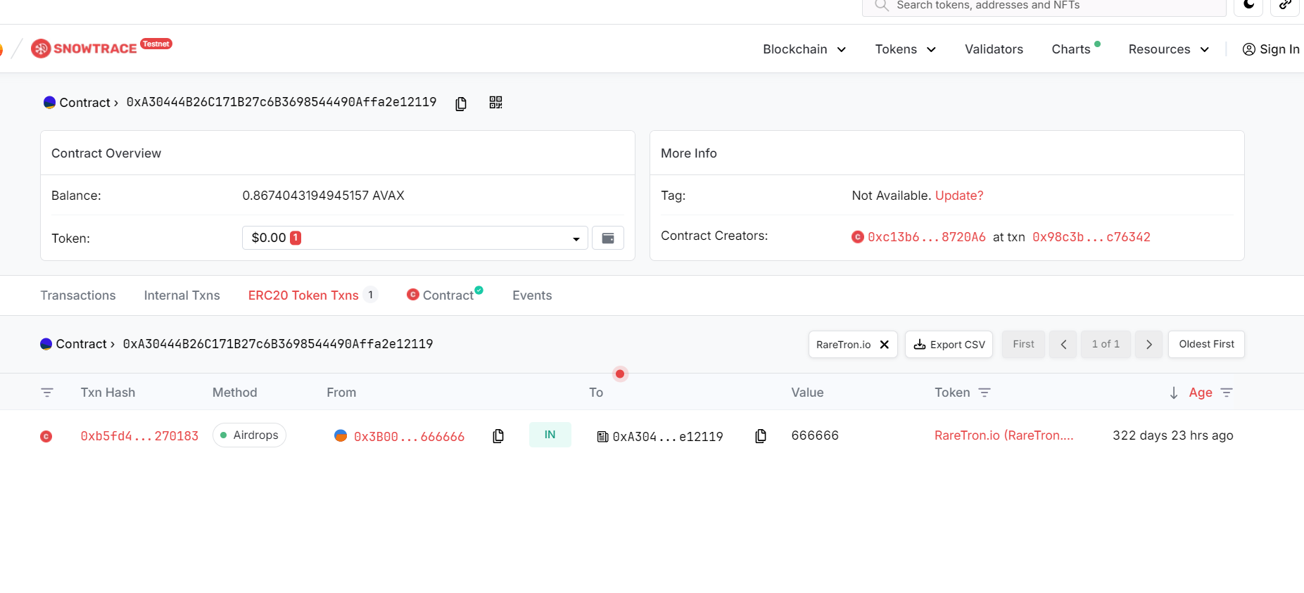
Block-Chain
Hardhat is used to compile, deploy, and test the smart contracts. The deployment configuration is specified in the hardhat.config.js file.

Slide 28
Interface
05
Our Interface

Slide 29
THEORETICAL FRAMEWORK
Home
Register/connect wallet
OUR
INTERFACE
Create Battle
Join Battle
Battle

Slide 30
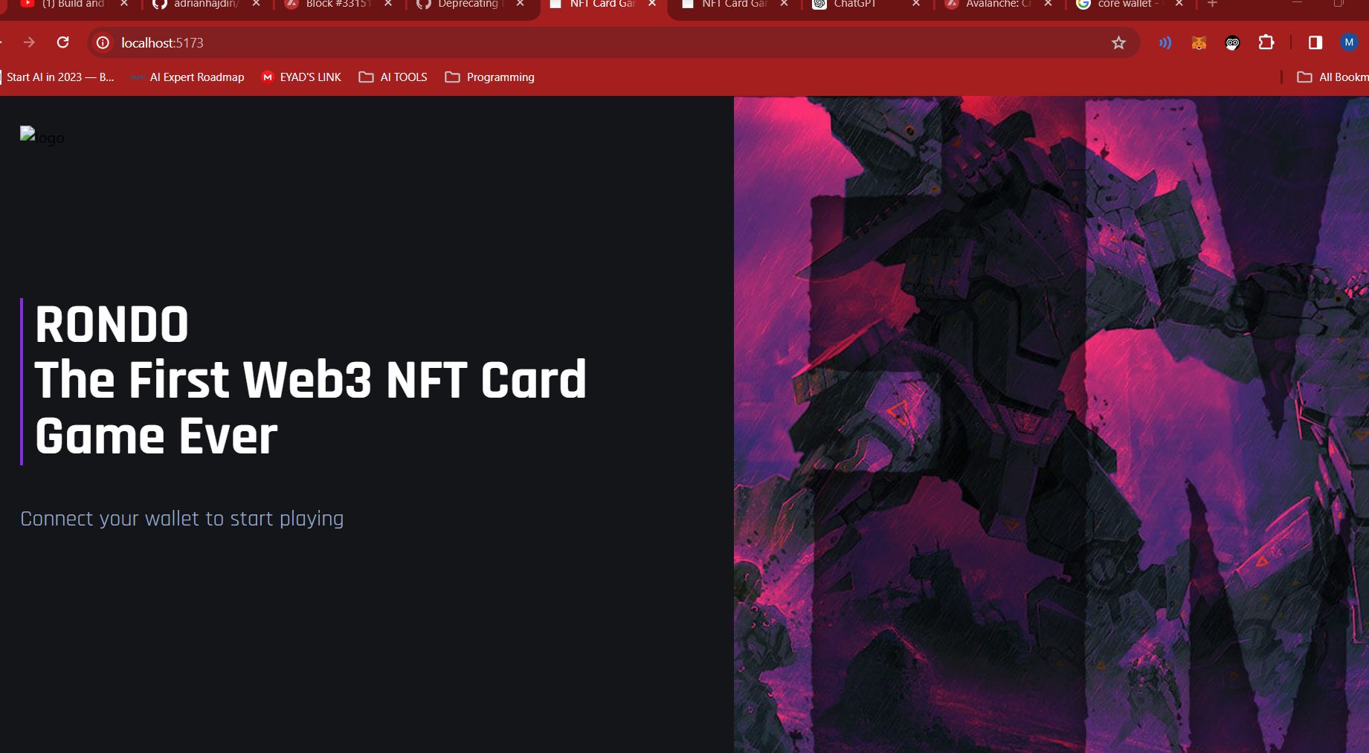
HOME

Slide 31
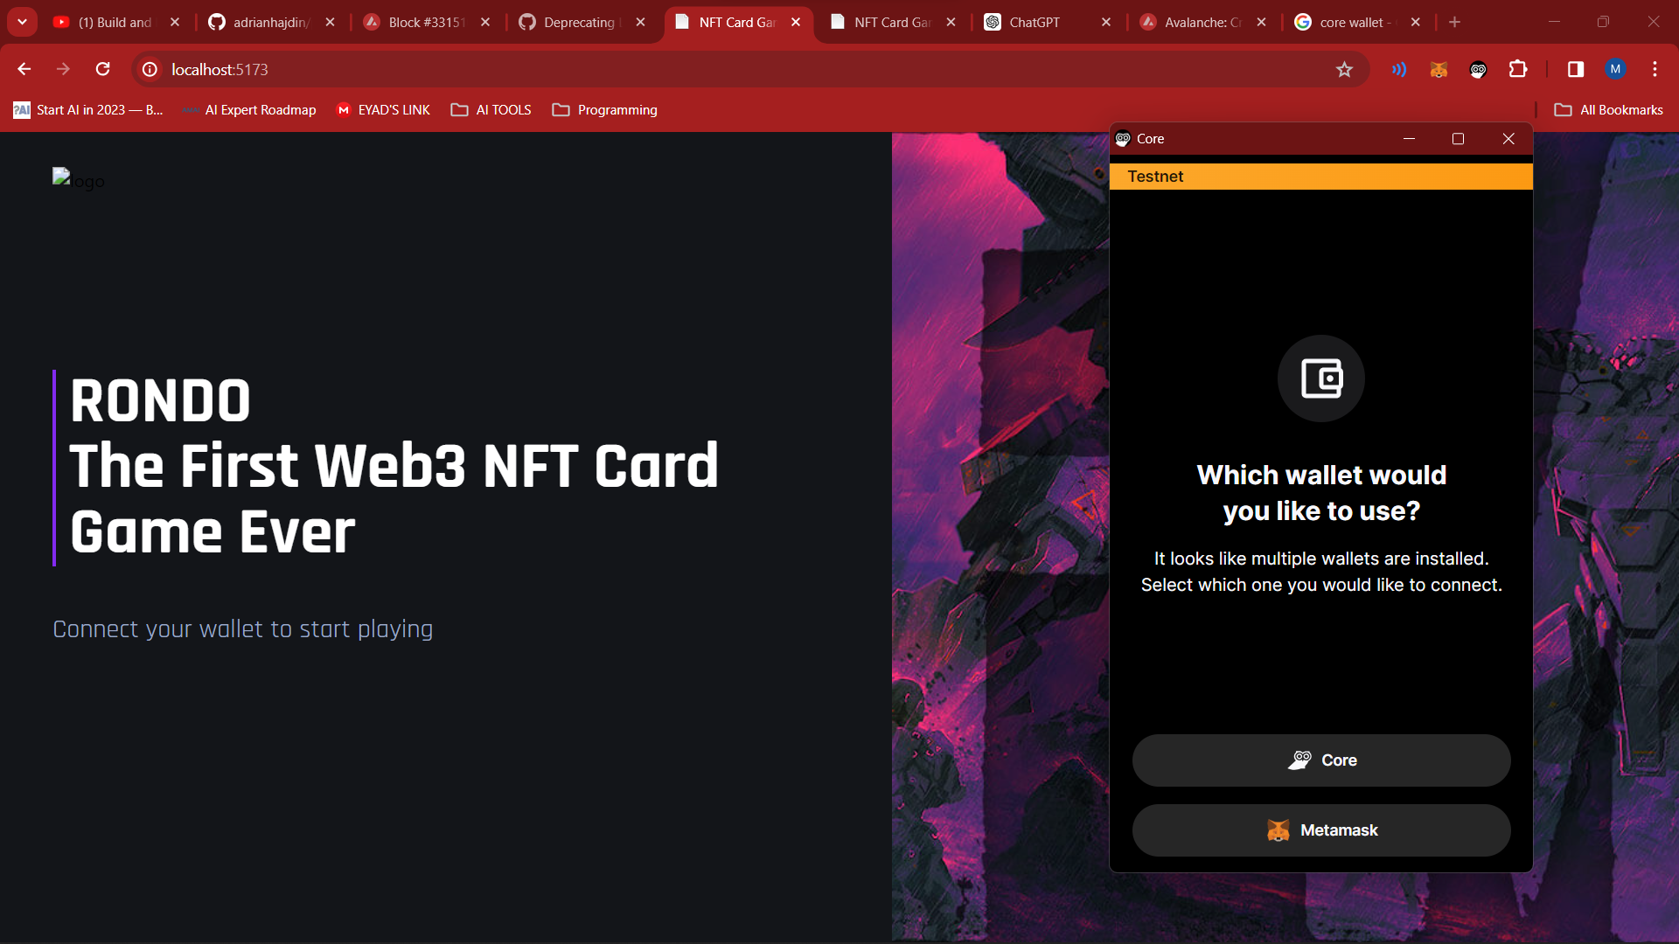
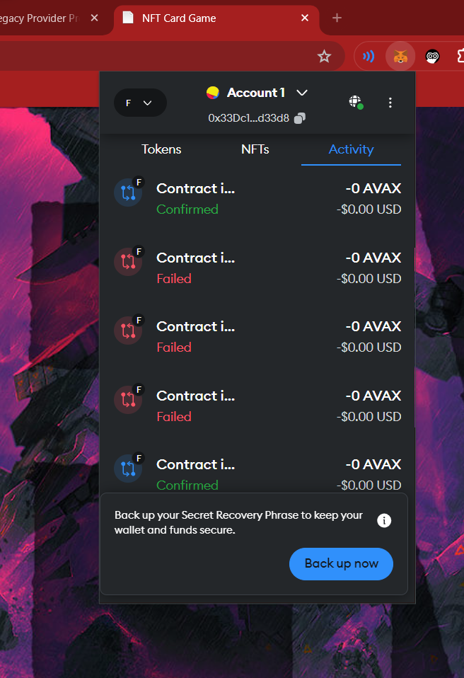
Register

Slide 32
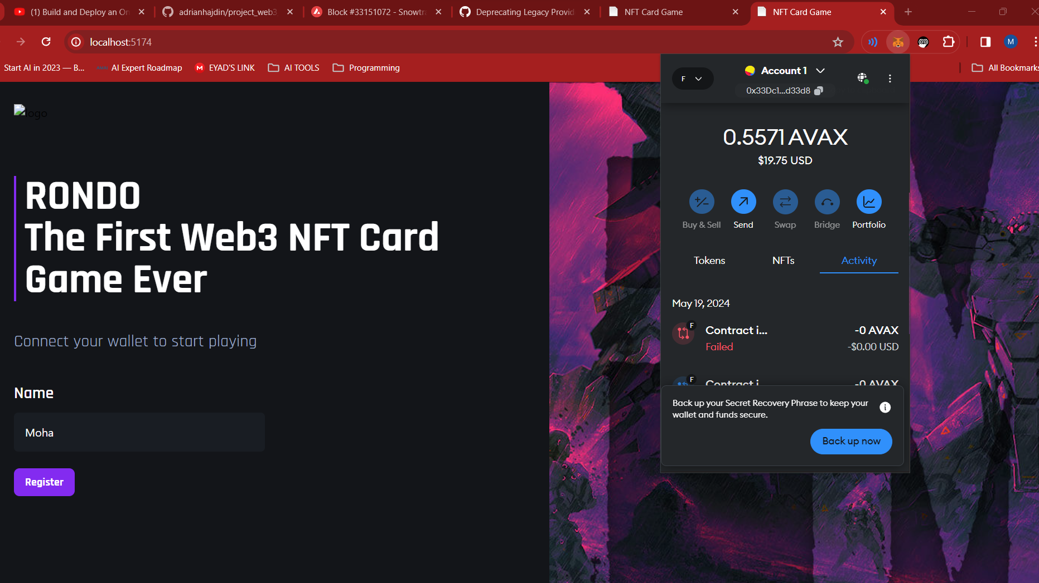
Register

Slide 33
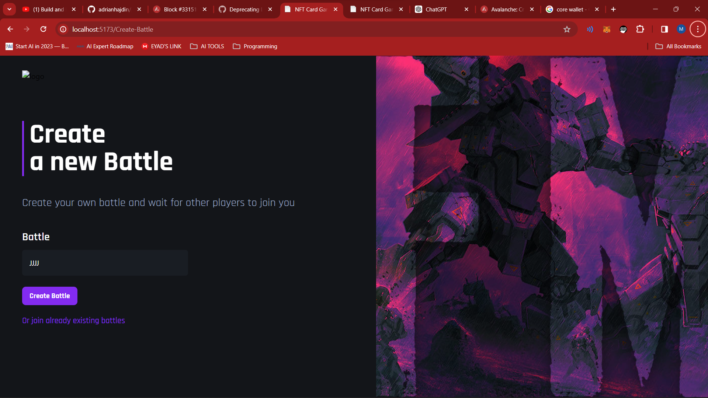
Create Battle

Slide 34
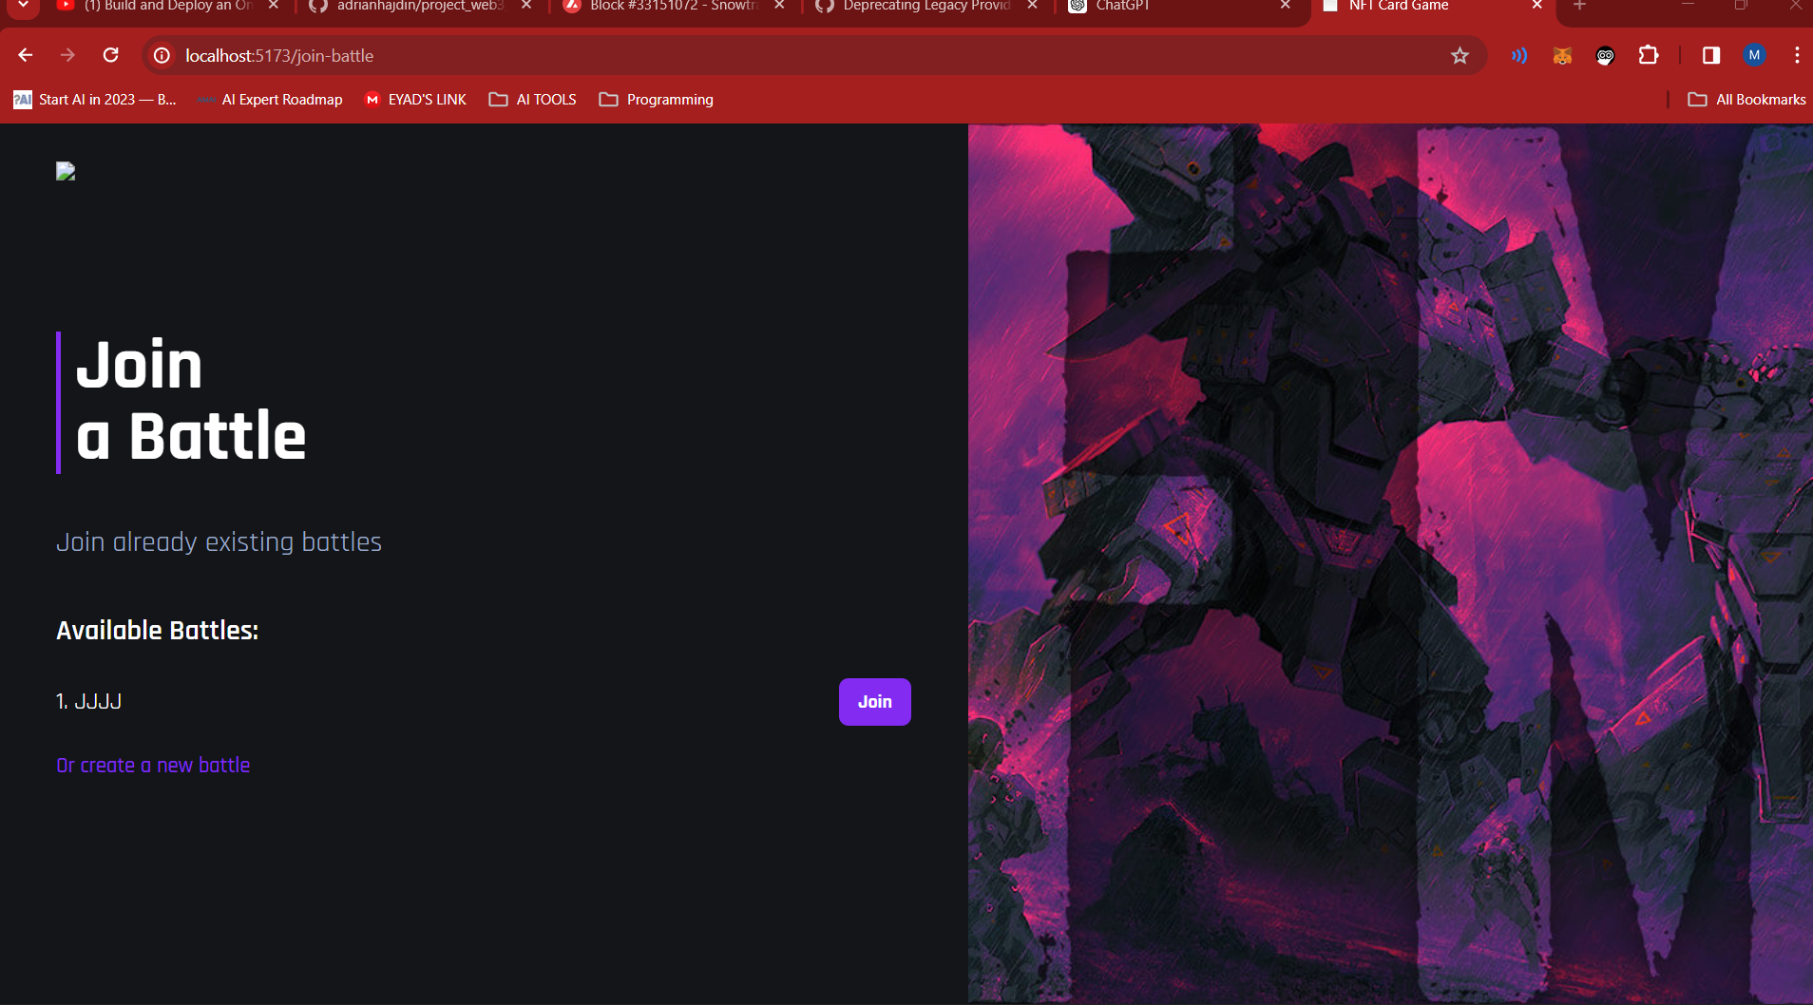
Join Battle

Slide 35
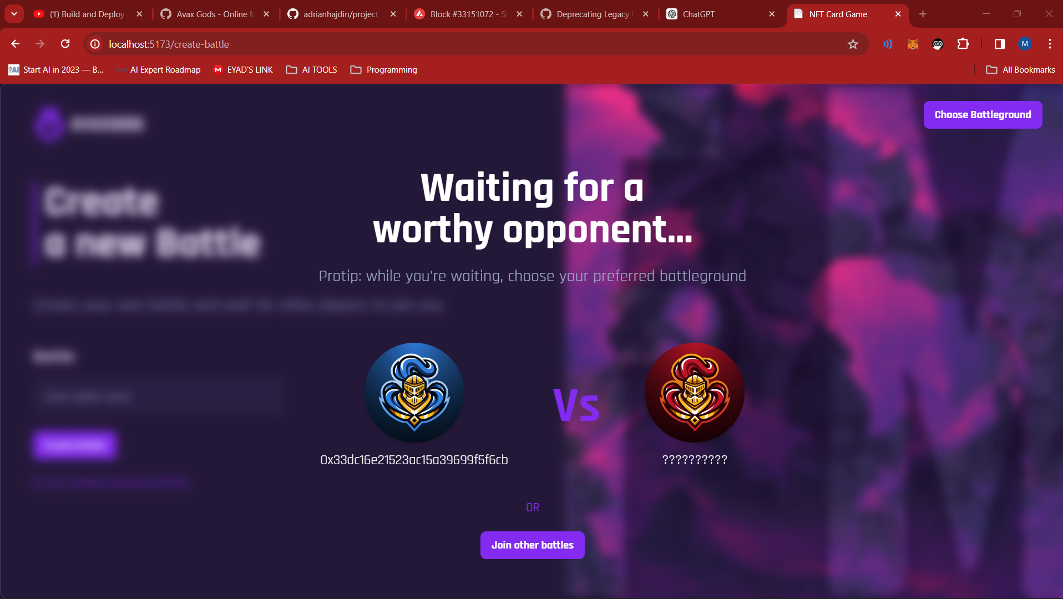
Join Battle

Slide 36
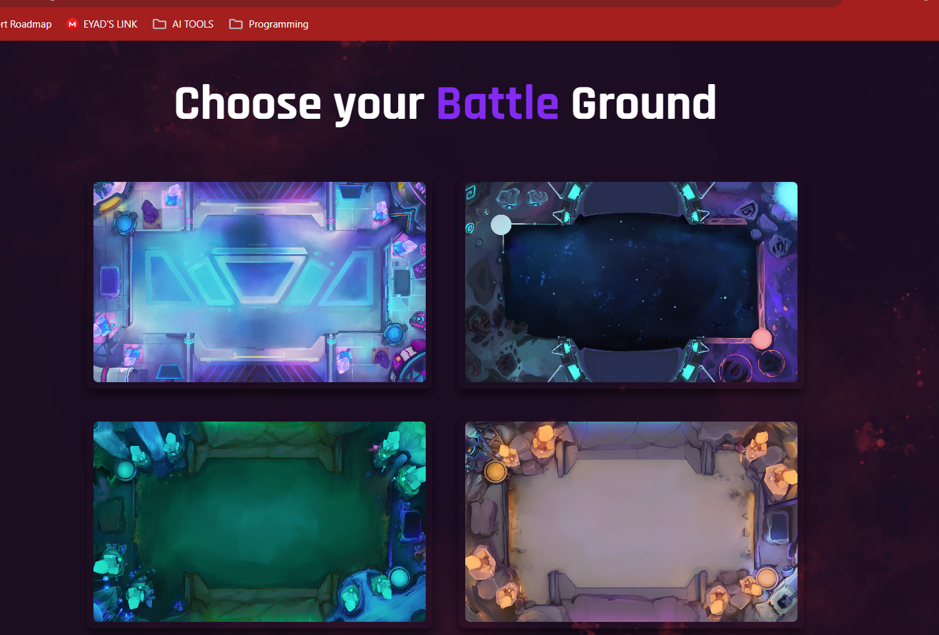
Join Battle

Slide 37
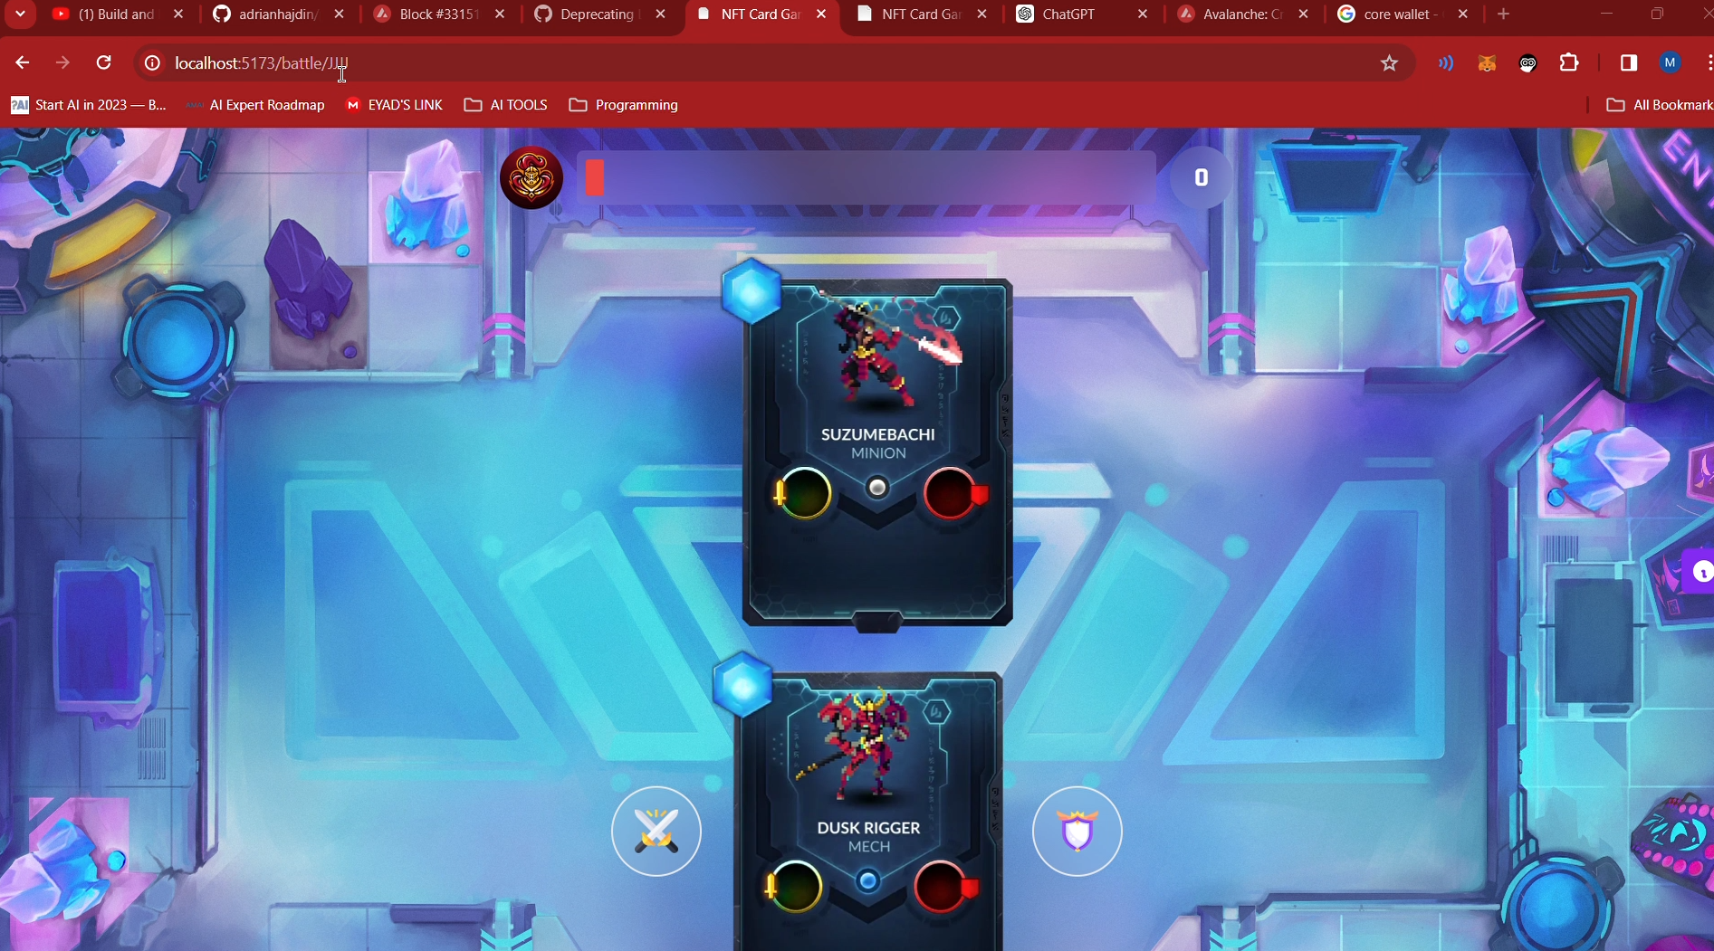
Battle

Slide 38
Conclusion
06
Steps for the building the project

Slide 39
The Rondo smart contract represents a significant advancement in the realm of NFT-based gaming.

Slide 40
What to do in future ?
Enhanced Security
Cross-Platform
Gameplay Features
01
02
Implement multi-signature wallets and secure smart contract auditing to protect user assets and prevent vulnerabilities
Develop mobile and desktop versions of the game to reach a wider audience and provide a seamless gaming experience across different devices.
03
Introduce more complex game mechanics, such as tournaments, leaderboards, and guilds, to enhance player engagement and competitiveness.

Slide 41
THANKS!

